Slide 1
ENG4118/5326 - Robotics 4/M Sensors, Actuators and Image capture, processing and analysis
Lecture 6
Kevin Worrall

Slide 2
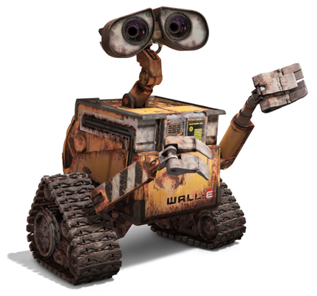
Overview
Optical Encoders
Velocity Sensors
Rate Gyroscope
Acceleration Sensors
Review

Slide 3
Optical Encoders

Slide 4
Optical Encoders
Encoder is a device which provides a digital output in relation to an angular displacement
Position encoders falls into two categories Incremental or Absolute
Incremental encoders detect changes in position from some reference (datum) position
Absolute encoders give actual angular position
The advantage of this type of sensor is that they are contactless detectors which avoid wear issues but must be kept clean

Slide 5
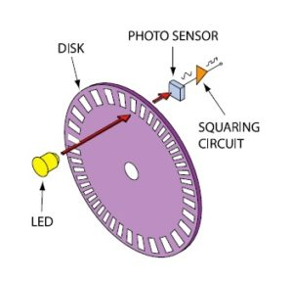
Optical Encoders
Incremental encoders utilise a light source and light detector
The light source passes through slots in the disk and is detected by the light detector.
When the disk is rotated a pulsed output is produced by the detector with the number of pulses produced being proportional to the angle through which the disk has rotated

Slide 6
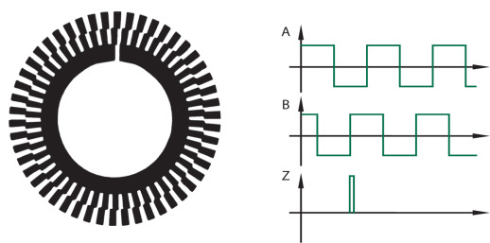
Optical Encoders
In practice three concentric disk tracks are used with three LED/detector pairs.
The innermost ring has a single hole and is used to locate the home position of the disk
The two outer tracks have a series of equally spaced holes which are offset to one another which allows the direction of rotation to be determined
In a clockwise rotation, the pulses from the outer track lead those from the inner track and the opposite is true for the anti-clockwise direction
Encoder resolution is determined by the number of slots on the disk e.g. for 60 slots in 1 revolution the resolution is 360°/ 60=6°

Slide 7
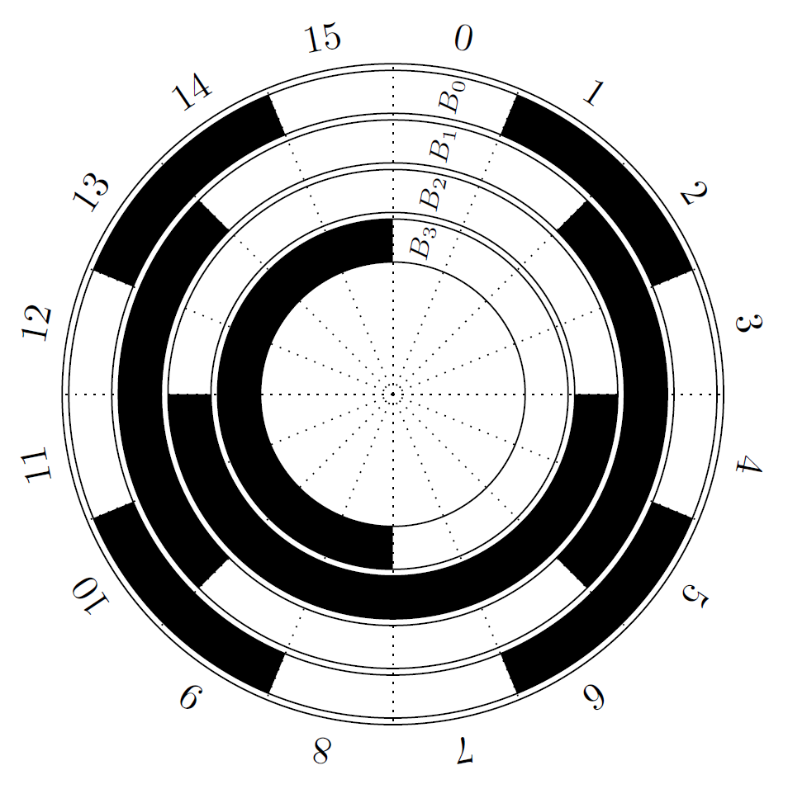
Optical Encoders
Absolute encoders produce a unique code for every position of shaft
The output from the detector is in the form of a binary number
The rotating disk opposite has four concentric circles of slots and four detectors to detect the light pulses

Slide 8
Optical Encoders
These slots are arranged such that the sequential output from the detectors is a number in binary code
Typical encoders have up to 10 or 12 tracks and the number of bits in the binary number will be equal to the number of tracks
Thus with 10 tracks there will be 10 bits so the number of positions that can be detected is 2^10 =1024
This gives a resolution of 360°/ 1024=0.35° for a single rotation of the disk
The normal form of binary code isn’t used since changing from one binary number to the next can result in more than one bit changing
To overcome this Gray Code is used with only one bit changing from one number to the next.

Slide 9
Optical Encoders
Decimal | Binary | Gray
0 | 0000 | 0000
1 | 0001 | 0001
2 | 0010 | 0011
3 | 0011 | 0010
4 | 0100 | 0110
5 | 0101 | 0111
6 | 0110 | 0101
7 | 0111 | 0100
8 | 1000 | 1100

Slide 10
Optical Encoders
Incremental Encoder
https://www.youtube.com/watch?v=zzHcsJDV3_o
Absolute Encoder
https://www.youtube.com/watch?v=yOmYCh_i_JI

Slide 11
Velocity Sensors

Slide 12
Velocity Sensors
Designed to measure the velocity of the system
With some calculations incremental encoders can be used as velocity sensors
Other velocity sensors exist...
Keep in mind Appropriate use!

Slide 13
Velocity Sensors
Tachometer
A tachometer is a generator which converts mechanical energy into electrical energy
Its output is an analogue voltage proportional to the input angular speed.
Tachometers are generally inaccurate at very low speeds
Non-linearity for these sensors is typically ±0.15% and they can operate up to speeds of 10,000 rpm

Slide 14
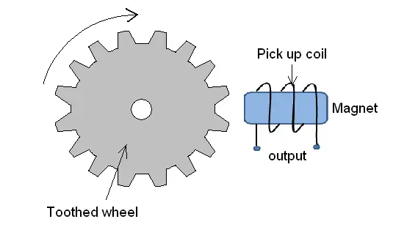
Velocity Sensors
Variable reluctance tachometer
Uses a toothed wheel of ferromagnetic material which is connected to a rotating shaft and a coil to sense angular velocity again using a process of counting pulses.

Slide 15
Velocity Sensors
A pickup coil is wound around a permanent magnet and as the wheel rotates the teeth move past the coil thus changing the air gap between the ferromagnetic material and the coil
The changing flux due to the change in air gap between the coil and ferromagnetic teeth produces an alternating emf in the coil
If the wheel has n teeth and rotates with angular velocity ω, the flux change with time is of the form:
Φ = Φ₀+ Φ_{V} cos(n.ω.t)
Where Φ₀ is the mean value of the flux and Φ_{V} is the amplitude of flux variation due to the presence of the toothed wheel

Slide 16

Velocity Sensors
The induced emf in the N turns of the pickup coil is given by:
where the maximum value of the induced emf is
and is thus a measure of the angular velocity
$$emf=−N.\frac{dφ}{dt}=N.φ_{V}.n.ω.sin\left(n.ω.t\right)=E_{max}.sin\left(n.ω.t\right)$$
$$E_{max}=N.φ_{V}.n.ω$$

Slide 17
Rate Gyroscope

Slide 18
Rate Gyroscope
Rate Gyroscopes
Measures rate of change of angle with time
Very common
Accuracy varies, as does the price
Very fast to respond
Different ranges exist <±50°s-1 to >±1000°s-1

Slide 19
Rate Gyroscope
Various technologies exist
From laser to mems
MEMs (MicroElectroMechanical systems )
mechanical devices built onto semiconductor chips
Consist of microprocessor, micro-sensors and micro-actuators and can sense, control and activate mechanical processes on a micro-scale.
MEMS range in size from 20 micrometres to 1mm with components 0.001 to 0.1 mm in size
Introduction to MEMs Gyroscope
https://www.youtube.com/watch?v=XsjvaYAFN1M
Basic principle is that an angular acceleration affects the system and this effect is detected
Principle use is to detect the angular speed of a system
Output can be integrated to get angular position

Slide 20
Acceleration Sensors

Slide 21
Acceleration Sensors
Accelerometers measure the accelerations along the axis that the accelerometers have been attached to
The design of an accelerometer is varied
Some use a mass on beam that in turn is connected to a potentiometer
Some are based on a capacitive effect
Others are piezoelectric or piezoresistive
And some can be LVDT based...

Slide 22
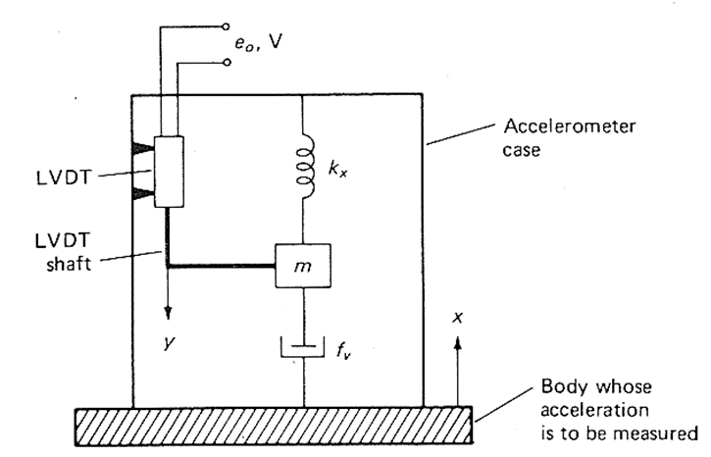
Acceleration Sensors
LVDT Method
The sensor detects acceleration by sensing the displacement of a mass restrained by a spring with a dashpot providing viscous resistance.
The force exerted by the spring is proportional to spring extension (Hook’s Law) and force exerted by the dashpot is proportional to the LVDT shaft velocity.

Slide 23
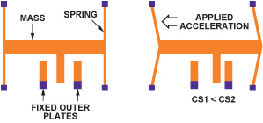
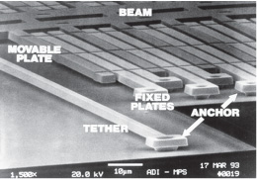
Acceleration Sensors
Most accelerometers you will come across are MEMs devices
MEMs based:
https://www.youtube.com/watch?v=4kfzqZpttTA

Slide 24
Acceleration Sensors
Applications
Measuring Acceleration
Detecting Accelerations
Air bags are often the example used
Output can be integrated for velocity
Issues
Drift
Often need reset with an external source
Output is either filtered or requires to be filtered

Slide 25
Review
Optical Encoders
Velocity Sensors
Rate Gyroscope
Acceleration Sensors

Slide 26
References
Bolton, W., Mechatronics, 5th Edition, Pearson, 2012
Chapter 2 - Sections 2.1 and 2.2
Niku, S.B. , Introduction to Robotics, 2nd Edition, Wiley, New Jersey, 2011.

